Slide 1
Streaming Session-Based Recommendation: When Graph Neural Networks meet the Neighborhood
By Sara Latifi sara.latifi@aau.at University of Klagenfurt Austria and Dietmar Jannach dietmar.jannach@aau.at University of Klagenfurt Austria
Paper Review by: Karishma Kuria

Slide 2
Streaming Session-Based Recommender
Streaming-Based Recommendation (SR):
SR refers to the task of finding the best recommendation for the users based on the previous recorded user interaction with the system.
Streaming Session-Based Recommendation (SSR):
One of the most challenging task in which the recommendation is provided based on the short term interest of the user in any live session.
SSR has its application in the fields of news recommendation, e-commerce applications and social media recommendations.
All SSR methods uses the class of techniques that incorporates online machine learning and incremental updates without re-training the model.

Slide 3
Challenges of SSR
Uncertainty of user behaviour.
Continuous, high volume and high velocity of the streaming data
High cost involved in computational logics and retraining of these models.

Slide 4
Goal of the experiment
Reproducing the results of GNN method.
Show the potential of simpler models such as KNN which can be used as baseline models for SSR applications.

Slide 5
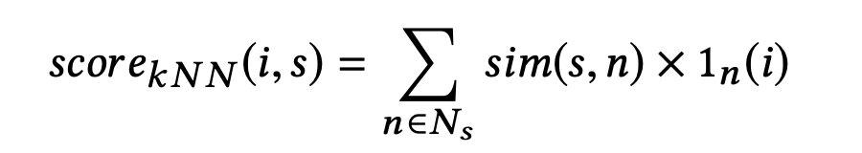
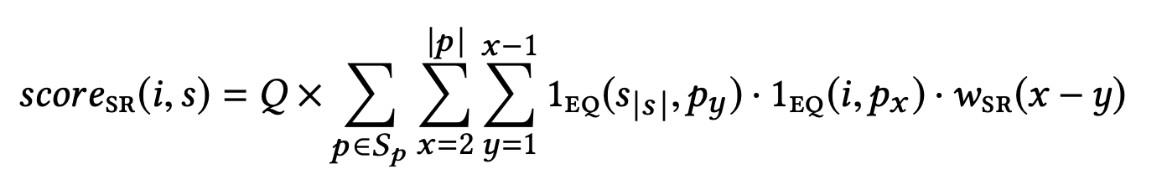
SSR Algorithms and Models
GAG model
VSKNN+
Sequential Rules (SR)+
Hybrid model (combination of VSKNN+ and SR+)

Slide 6
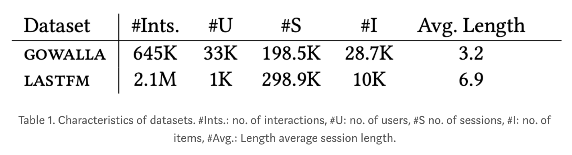
Datasets
For this experiment we have used two pre-trained datasets by GAG author’s
GOWALLA: Check-in information from a location-based social network
LASTFM: Music listening session data

Slide 7
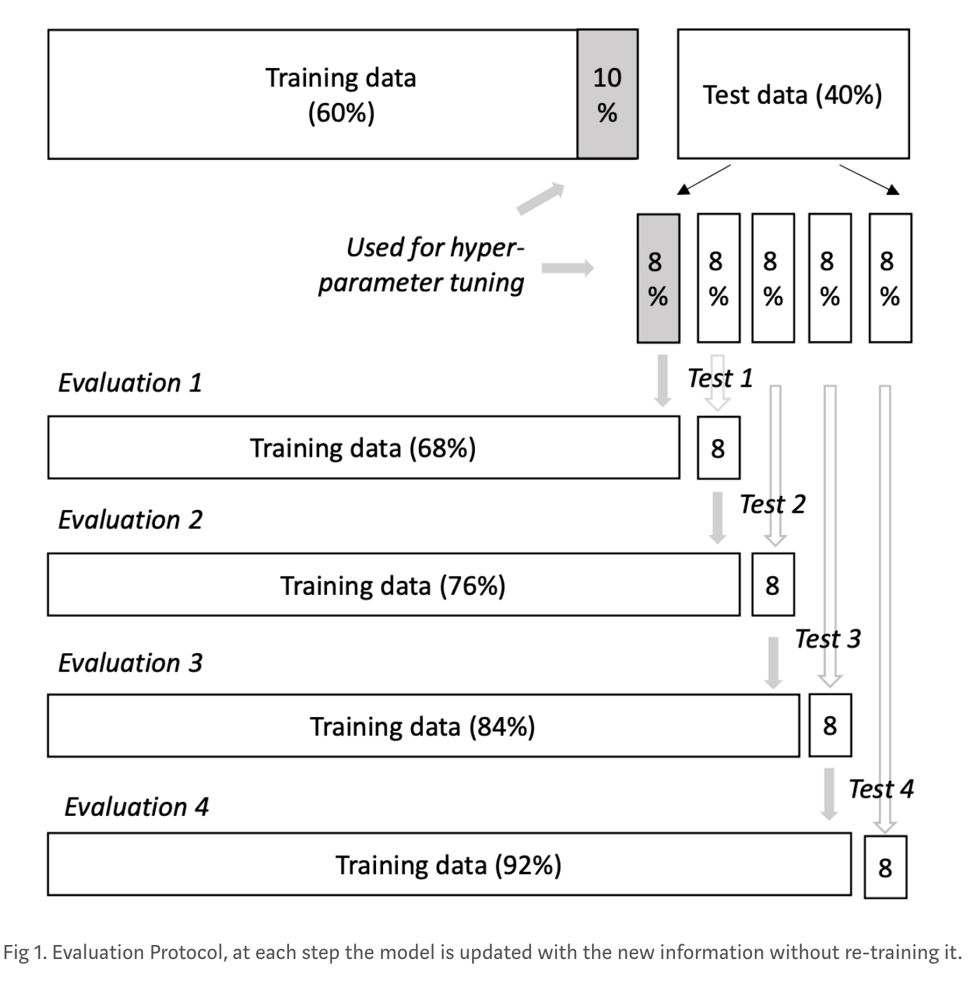
Evaluation Protocol and Hyper-Parameter tuning

Slide 8
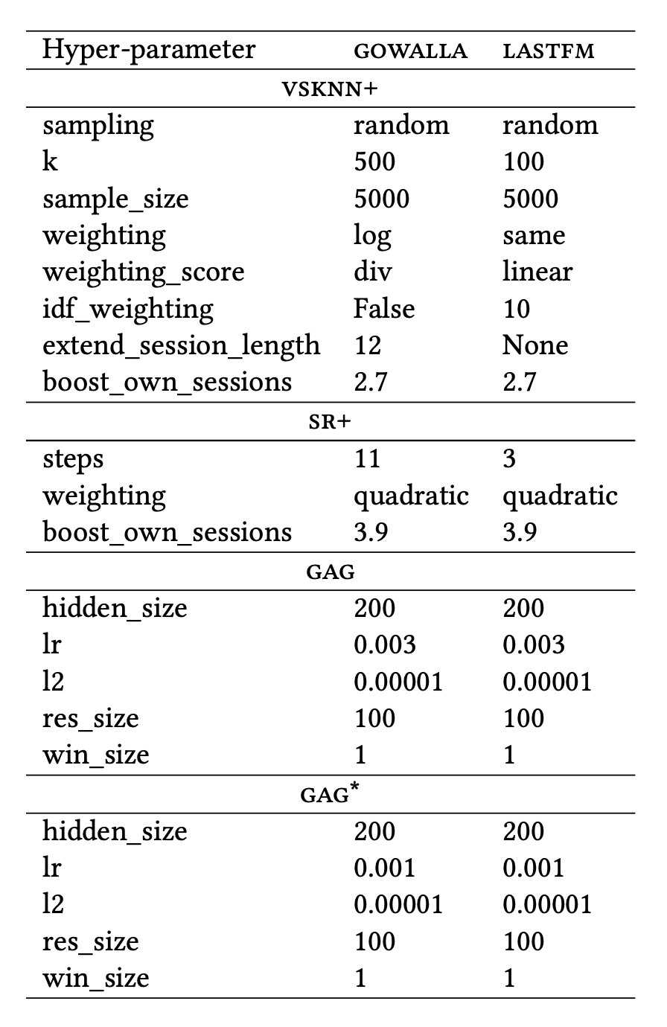
Hyper-Parameters

Slide 9
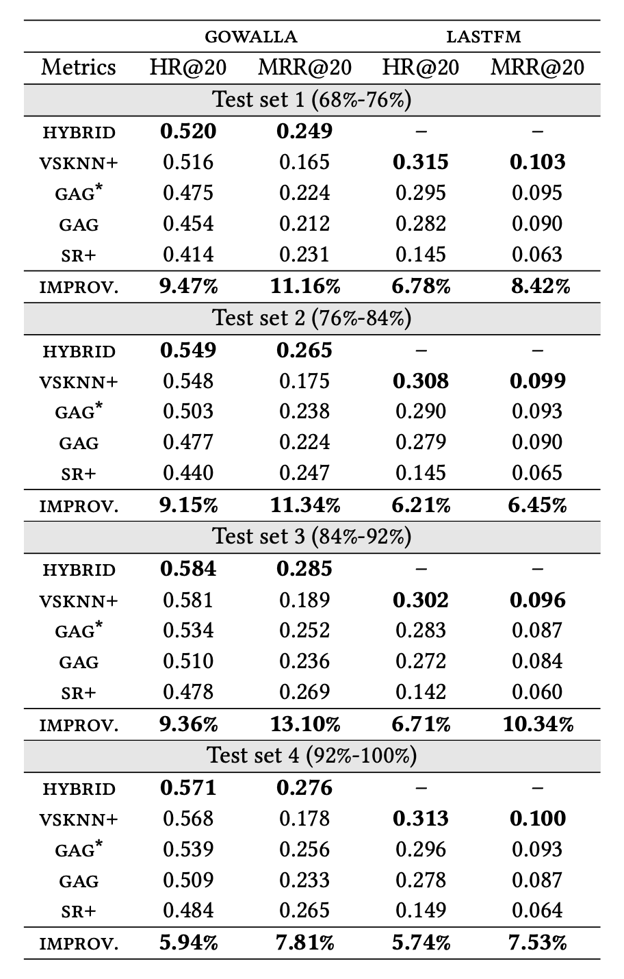
Results

Slide 10
Conclusion
With this experiment we have concluded that simpler methods can be used as baseline models for applications of Streaming Session-Based Recommenders since they have outperformed state-of-art models like GAG.
It was noticed that the choice of datasets for SSR models evaluation is not appropriate in the recent research.
In future more research can be done on evaluating the performance of these state-of-art models with more relevant datasets.

Slide 11
References
Streaming Session-Based Recommendation: When Graph Neural Networks meet the Neighborhood
https://medium.com/@karishma.kuria_14153/streaming-session-based-recommendation-when-graph-neural-networks-meet-the-neighborhood-afa8156f1ca9

Slide 12
Thank You

